Slide 1
Java EE 101
Reza Rahman
Java EE/GlassFish Evangelist
reza.rahman@oracle.com
@reza_rahman

Slide 2
Program Agenda
Java EE Overview
API Overview
Cargo Tracker Demo
Looking Ahead

Slide 3




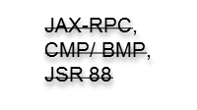




Java EE Past, Present and Future
Java EE 7
JMS 2, Batch, Concurrency, JSON, TX Interceptor, WebSocket
Java EE 6
Pruning,
Extensibility
Ease of Dev,
CDI, JAX-RS
Java EE 5
Ease of
Development,
EJB 3.0, JPA, JSF, JAXB, JAX-WS, StAX, SAAJ
J2EE 1.4
Web Services
Mgmt, Deployment,
Async
Connector
J2EE 1.3
CMP,
Connector
Architecture
Web Profile
JAX-RS 2.0
J2EE 1.2
Servlet, JSP, EJB, JMS, RMI
Web Profile
Servlet 3.0, EJB 3.1 Lite

Slide 4








Java EE Today

Slide 5
Java EE Today
Core Principles
Open vendor neutral technical standard
Stable core for a vibrant ecosystem
Fully integrated runtime, intelligent defaults and convention-over-configuration
Non-redundant APIs with specialized roles
Java centric – strong static typing, strongly Object Oriented, focused on simplicity, strongly backwards compatible

Slide 6
Java EE Today
What it is Not
No XML hell
No configuration hell
No jar/dependency hell
No feature bloat
No snake-oil/hypeware
No bloated deployments
No lock-in

Slide 7
Java EE
JAX-WS
JSF
JAX-RS
EL
Bean Validation
Concurrency
Utilities
JavaMail
Servlet
JAXB
Batch Applications
JPA
CDI
Java API for
JSON
JMS
EJB 3
Java API for
WebSocket
JCA
JTA
JASPIC
JACC
New
Major
Release
Updated

Slide 8
JSF
Abstract, high-level web framework
True MVC, component oriented, productive
Facelets for view
  XHTML
  Templating
  Composite components
Data, event binding to CDI via EL
Validation, conversion, navigation, flow
Supports AJAX, HTML 5
Strong plug-in ecosystem
  PrimeFaces, RichFaces, ADF Faces

Slide 9
JSF API
Facelets tags
  <ui:composition>, <ui:define>, <ui:insert>, <ui:component>, <ui:repeat>
HTML tags
  <h:form>, <h:inputText>, <h:selectOneMenu>, <h:commandButton>, <h:commandLink>, <h:panelGrid>
Core tags
  <f:convert...>, <f:validat...>, <f:ajax>
Event/data binding to CDI via EL
  <h:inputText … value=“#{hello.name}” …>
CDI Scopes
  @ViewScoped, @FlowScoped

Slide 10
CDI
Next generation type-safe dependency management
Robust contextual model
Interceptors/decorators
Type-safe events
Portable extensions API to integrate third-party tools and frameworks cleanly to Java EE
  DeltaSpike, Seam 3, Forge
Improving testability
  Arquillian

Slide 11
CDI API
Basic dependency injection
  @Inject, @Qualifier, @Stereotype, @Alternative, @Named, @Produces, @Disposes
Context management
  @RequestScoped, @SessionScoped, @ConversationScoped, @ApplicationScoped, @Scope (@FlowScoped, @ViewScoped, @TransactionScoped)
Lightweight events
  Event, @Observes
Interceptors/decorators
  @Interceptor, @InterceptorBinding, @AroundInvoke, @Decorator, @Delegate
Portable extensions SPI

Slide 12
EJB 3
Enterprise service components
  Thread-safe, transactional, pooled
Lightweight, portable, testable, POJO based
Component types
  @Stateless, @Stateful, @Singleton, @MessageDriven
Declarative services
  @TransactionAttribute (CDI/JTA @Transactional), @RolesAllowed, @RunAs, @Asynchronous, @Schedule, @Lock, @Remote

Slide 13
JPA
ORM mapping/domain modeling
CRUD EntityManager API
Rich query capabilities
  JPQL
  Criteria Queries
  Native Queries
  Stored procedures
Caching

Slide 14
JPA API
Domain modeling
  @Entity, @Embeddable, @OneToOne, @OneToMany, @ManyToOne, @ManyToMany, @ElementCollection, @Id
Relational mapping
  @Table, @Column, @JoinColumn, @JoinTable, @Basic, @Lob, @Temporal, @Enumerated, @Cacheable
CRUD API
  EntityManager, Query, CriteriaQuery, @PersistenceContext, @NamedQuery, @NamedNativeQuery, @NamedStoredProcedureQuery

Slide 15
Bean Validation
Declarative constraint management across application layers
Constraint
  Restriction on a bean, field, property, method parameter, return value
  Not null, between 10 and 45, valid email, etc
  @Max, @Min, @Size, @NotNull, @Pattern, @Future, @Past
  Custom constraints
  Evaluated automatically
Integrated with JSF, JPA, CDI, JAX-RS

Slide 16
JMS 2
Reliable asynchronous messaging API for Java
Point-to-point (queues), publish-subscribe (topic)
Small, powerful API
  Message, Destination, Queue, Topic, ConnectionFactory, Connection, Session, MessageProducer, MessageConsumer, JMSContext, JMSProducer, JMSConsumer, MessageListener, @JMSConnectionFactory
Message types
  TextMessage, ObjectMessage, BytesMessage, MapMessage, StreamMessage

Slide 17
JAX-RS 2
REST development API for Java
Server and client
Annotation based, declarative
  @Path, @GET, @POST, @PUT, @DELETE, @PathParam, @QueryParam, @Produces, @Consumes
Pluggable and extensible
  Providers, filters, interceptors

Slide 18
Java API for WebSocket
High level declarative API for WebSocket
Both client and server-side
Small, powerful API
  @ServerEndpoint, @OnOpen, @OnClose, @OnMessage, @OnError, Session, Remote
Pluggable and extensible
  Encoders, decoders, sub-protocols

Slide 19


Java EE Demo Application
http://cargotracker.java.net

Slide 20
Java EE 8
JSON-B
JCache
CDI 2
More CDI/EJB alignment
Security
Action-oriented Web framework/HTML 5 alignment
Cloud, PaaS, multitenancy/SaaS
Configuration, deployment, management, monitoring?
Further pruning?

Slide 21
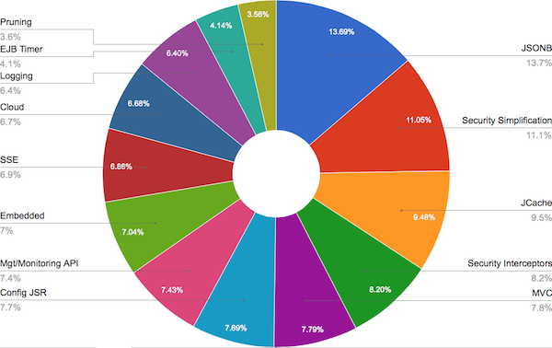
Java EE 8 Community Survey
https://blogs.oracle.com/ldemichiel/entry/results_from_the_java_ee
https://java.net/downloads/javaee-spec/JavaEE8_Community_Survey_Results.pdf

Slide 22

Try it Out!
http://dlc.sun.com.edgesuite.net/glassfish/4.0.1/promoted/

Slide 23
Resources
Java EE Tutorials
  http://docs.oracle.com/javaee/7/tutorial/doc/home.htm
Digging Deeper
  http://docs.oracle.com/javaee/7/firstcup/doc/home.htm
  https://glassfish.java.net/hol/
  https://java.net/projects/cargotracker/
Java EE 7 Transparent Expert Groups
  http://javaee-spec.java.net
Java EE 7 Reference Implementation
  http://glassfish.org
The Aquarium
  http://blogs.oracle.com/theaquarium

